Slide 1
Grover on Simplified AES
Kyung-Bae Jang, Gyeong-Ju Song, Hyun-Ji Kim, Hwa-Jeong Seo

Slide 2
Introduction
Related works
Proposed Method
Evaluation and Conclusion

Slide 3
Introduction
Quantum computers using quantum algorithms show greater computational power than classical computers in solving some problems.
Grover’s algorithm : Grover’s algorithm is a quantum algorithm finds specific data with high probability among unsorted data.
Grover’s algorithm can be used in a brute force attack to recover the key of symmetric key cryptography.
To do this, first, the encryption of the target cipher must be implemented as a quantum circuit so that it can be operated in a quantum computer.
In this paper, we efficiently implement Simplified AES as a quantum circuit. (In terms of optimization on a quantum computer, there are three elements: qubits, quantum gates, and circuit depth.)

Slide 4
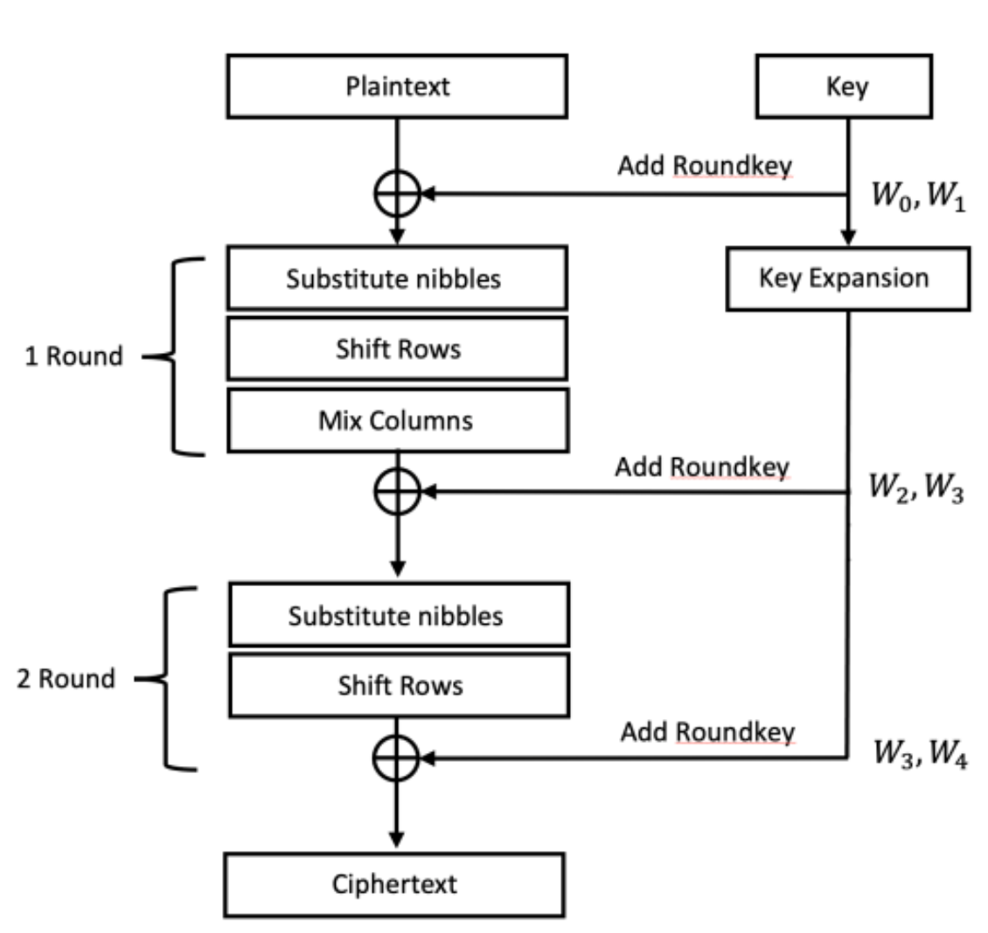
Related works
Simplified AES
Simplified AES (S-AES) is an algorithm that has simplified the existing AES.
It uses a 16-bit block plaintext and a 16-bit key and consists of a total of 2 rounds.
Like AES, each round consists of Substitute nibble, Shift Rows, Mix Columns, and AddRoundkey, and Key Expansion for generating round keys is performed.

Slide 5
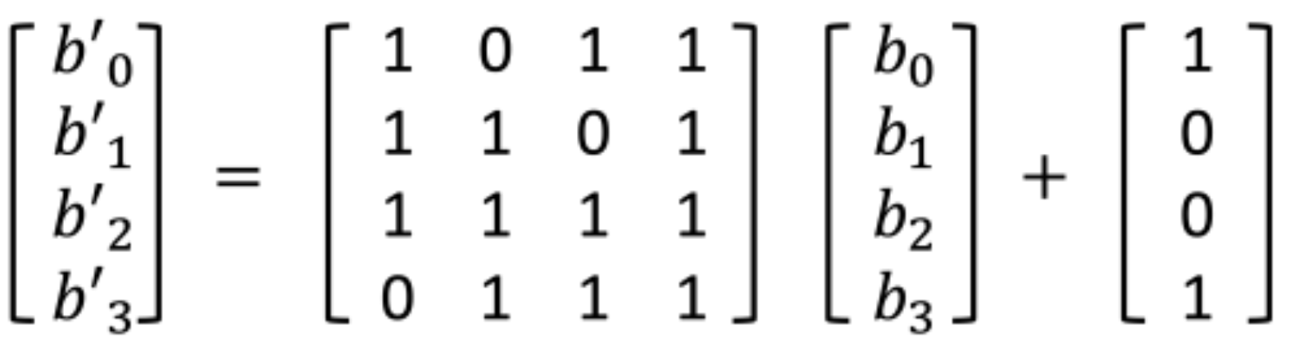
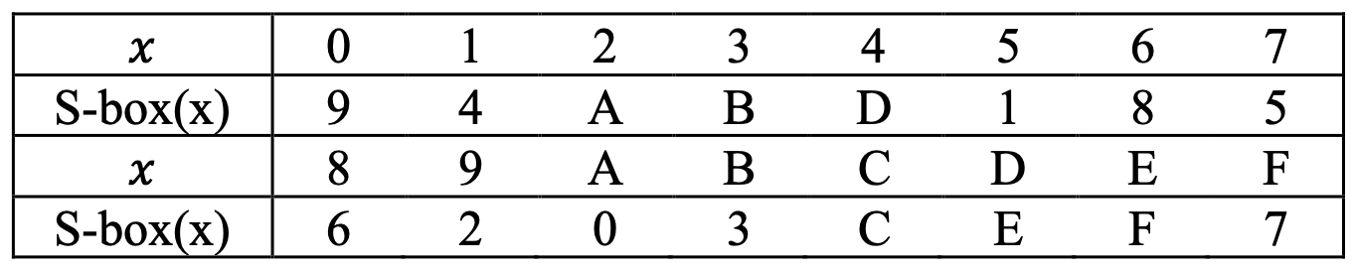

Related works
Simplified AES
Substitute nibble
S-AES performs the following substitution in 4-bit units for 16-bit blocks in the Substitute nibble.
S-AES performs 4-bit units for 16-bit blocks 4-bit ( $b_{0} b_{1} b_{2} b_{3}$) is expressed as a polynomial and converts it to an inversion of 𝐺𝐹(16) (field polynomial = $x^{4}+x+1$).
After that, the substitution is completed by performing matrix multiplication and vector addition (XOR).
Matrix multiplication and vector addition
S-box look up table

Slide 6
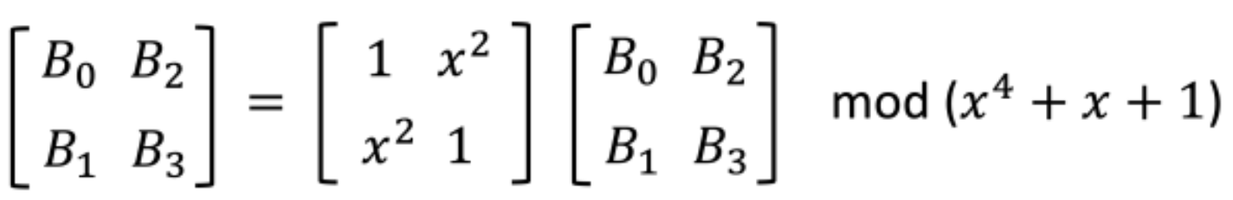

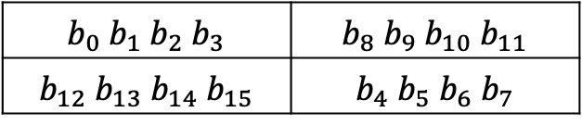
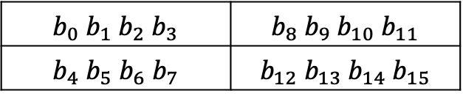
Related works
Simplified AES
Shift Rows
4-bit ($b_{4} b_{5} b_{6} b_{7}$) and 4-bit ($b_{12} b_{13} b_{14} b_{15}$) are interchanged.
Mix Columns
Mix Columns is performed on 16-bit block 𝐵.
$$b_{0} b_{1} b_{2} b_{3}$$ | $$b_{8} b_{9} b_{10} b_{11}$$
$$b_{4} b_{5} b_{6} b_{7}$$ | $$b_{12} b_{13} b_{14} b_{15}$$
$$b_{0} b_{1} b_{2} b_{3}$$ | $$b_{8} b_{9} b_{10} b_{11}$$
$$b_{12} b_{13} b_{14} b_{15}$$ | $$b_{4} b_{5} b_{6} b_{7}$$

Slide 7
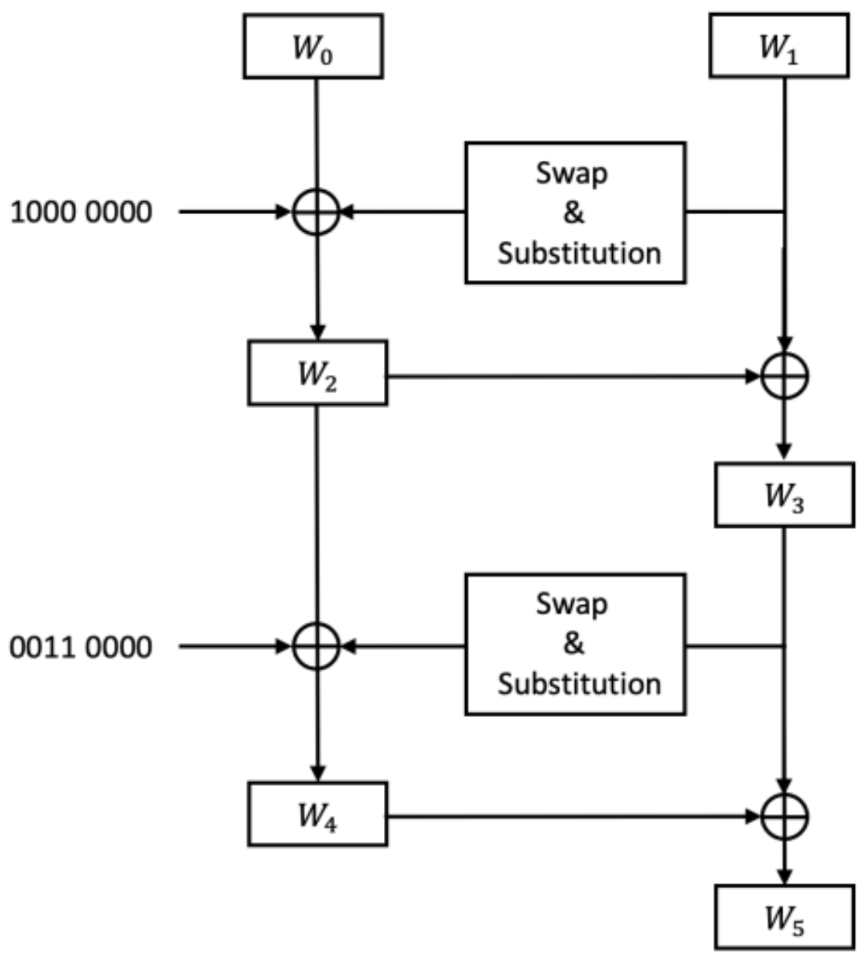
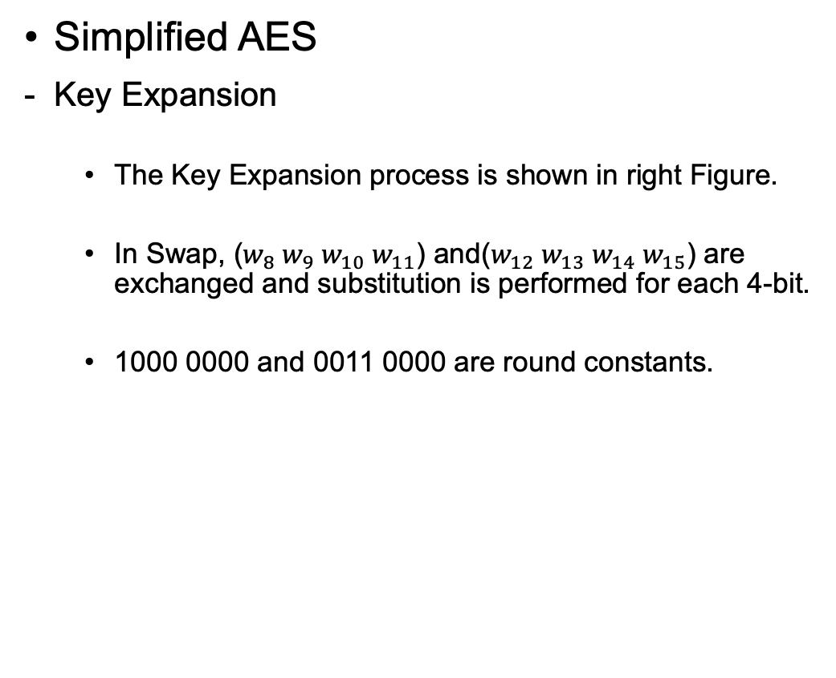
Related works
Simplified AES
Key Expansion
The Key Expansion process is shown in right Figure.
In Swap, ($w_{8} w_{9}{ w}_{10}{ w}_{11}$) and($w_{12} w_{13}{ w}_{14}{ w}_{15}$) are exchanged and substitution is performed for each 4-bit.
1000 0000 and 0011 0000 are round constants.

Slide 8
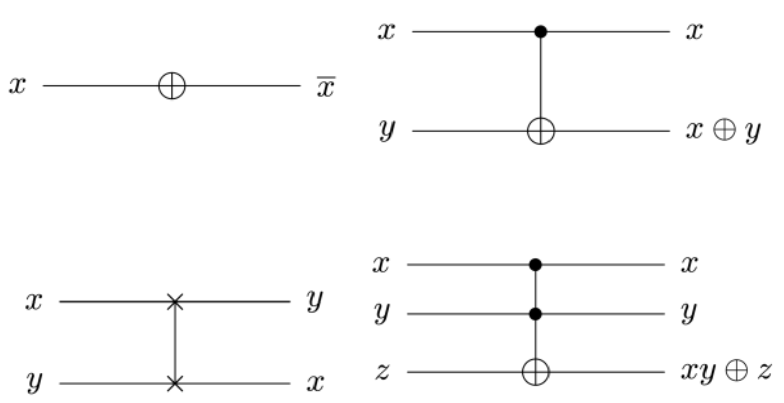
Related works
Quantum Computing
Quantum computers are reversible for all operations except observation.
In other words, it should be possible to restore the initial state again using only the output values.
The figure below shows a representative quantum gates with reversible characteristics that can replace logic gates of classical computers.
Not gate
CNOT gate
Swap gate
Toffoli gate

Slide 9
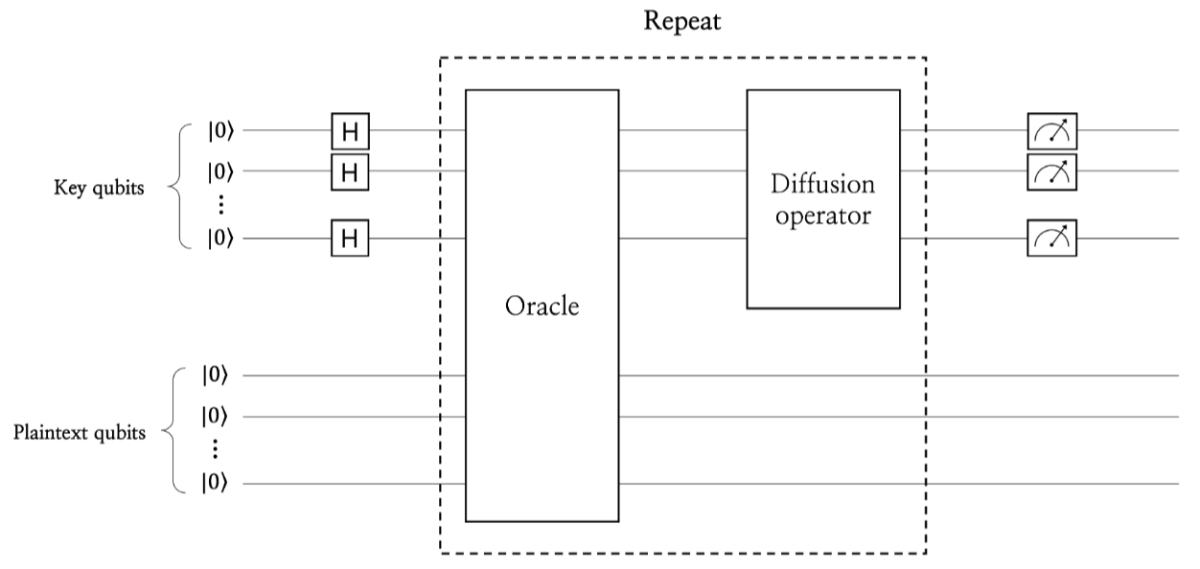

Related works
Grover Search Algorithm
Grover search algorithm consists of oracle and diffusion operator.
In Grover key search, oracle returns the key for known plaintext-ciphertext pairs. Because it operates in the superposition state, the diffusion operator amplifies the amplitude of the key returned by the oracle.
Grover key search search the key with high probability by repeating the oracle and diffusion operator $\left\lfloor \frac{π}{4}\sqrt{2^{n}}\right\rfloor$ times for an n-bit key.

Slide 10
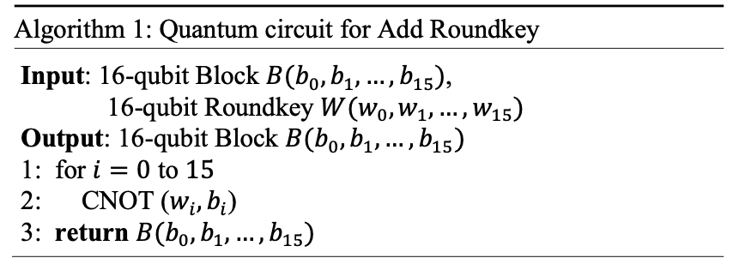
Proposed Method
Substitution, Mix Columns, and Key Expansion, which require a lot of quantum resources, are efficiently implemented in the proposed S-AES quantum circuit.
Through this, only 32 (16+16) qubits for the plaintext and key were used, and quantum gates and circuit depth were also reduced.
Quantum circuit for AddRoundKey
Add Roundkey XORs the 16-bit round key to the 16-bit block 𝐵.
The quantum circuit for Add Roundkey can be implemented with 16 CNOT gates, which is shown in Algorithm 1.

Slide 11
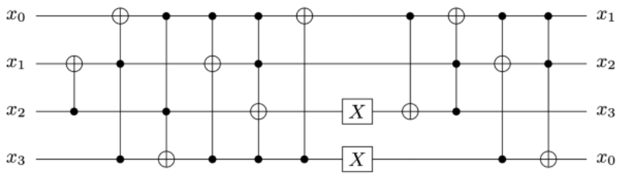
Proposed Method
Quantum circuit for Substitution
Implementing an S-box using a lookup table on a classic computer is a common choice. However, using a lookup table in a quantum computer in a superposition state is quite complex and inefficient. Thus, implementing S-box operations in ANF(Algebraic Normal Form) is a common choice in quantum computers.
We choose the implementation method based on the lookup table of S-box. Using the LIGHTER-R tool, the S-box is efficiently implemented with few quantum gates and no additional qubits.
LIGHTER-R generates a reversible ANF based on the input and output of the lookup table. Through this, it is possible to efficiently implement a quantum circuit for the S-box.
S-box quantum circuit implemented using LIGHTER-R

Slide 12
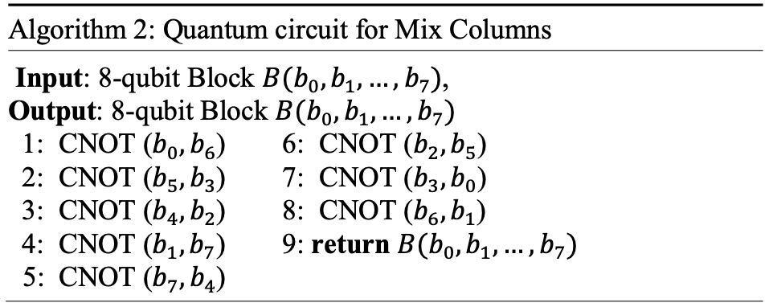
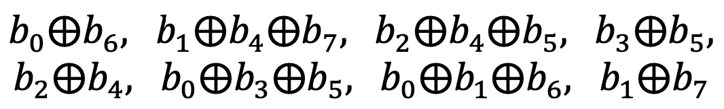
Proposed Method
Quantum circuit for Mix Columns
In this paper only 16(8 X 2) CNOT gates are used by implementing a quantum circuit based on the final result of the Mix Columns.
Below is the result after performing Mix Column to be implemented with quantum gates.
We performed CNOT gates with each other in 8- qubit to generate Mix Columns result most efficiently.
The quantum circuit for Mix Columns is shown in Algorithm 2. 16-qubit block is divided by 8-qubit to perform Mix Column (i.e. 32 CNOT = 2 ∙16 CNOT).

Slide 13
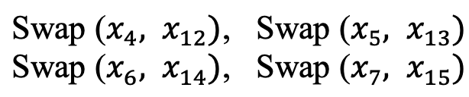
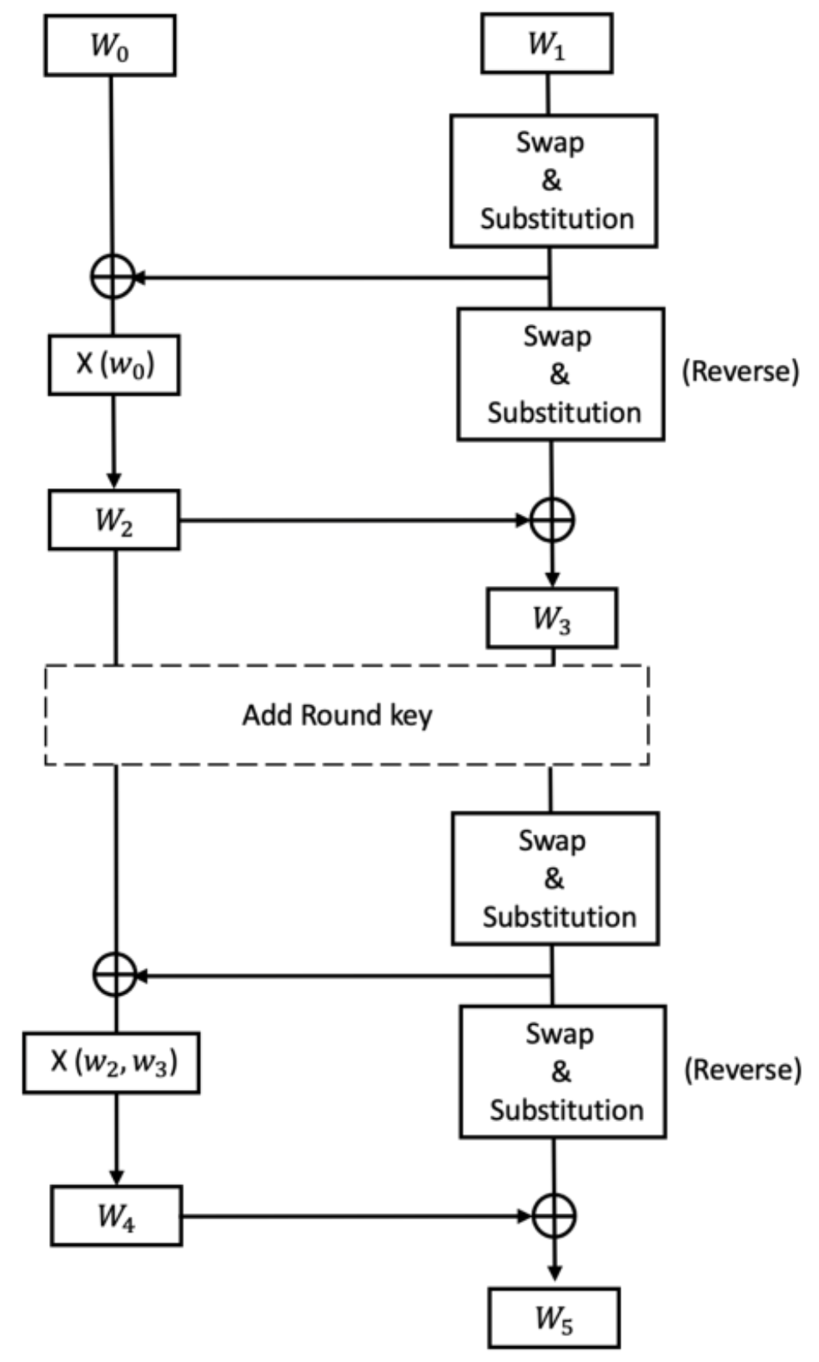
Proposed Method
Quantum circuit for Shift Rows
Shift Rows can be simply implemented with only Swap gates. The quantum circuit for Shift Rows using Swap gates is shown below and is not measured as quantum resources.
Quantum circuit for Key Expansion
We do not allocate qubits for storing round keys in S-AES.
Using the on-the-fly method, the input key is updated before Add Roundkey and used as a round key.
Proposed Key Expansion structure

Slide 14
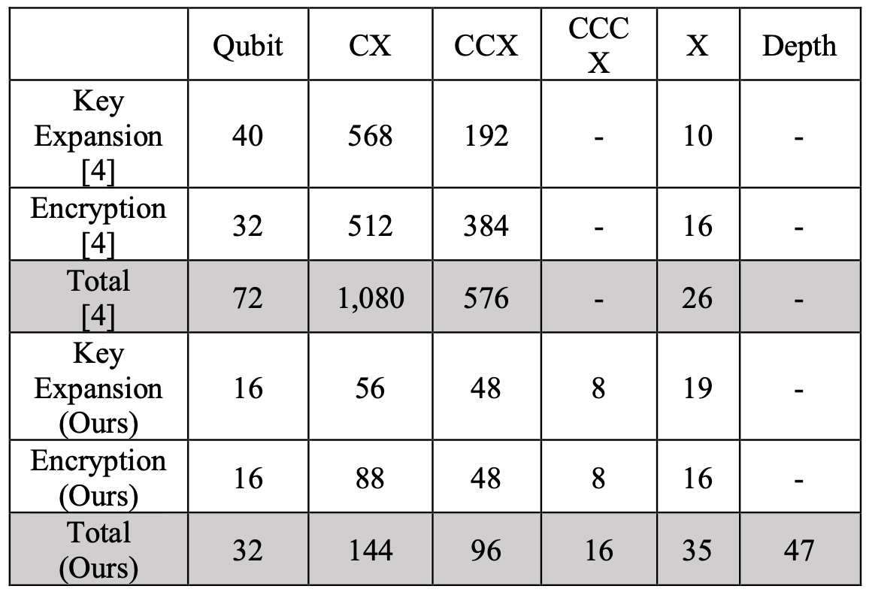
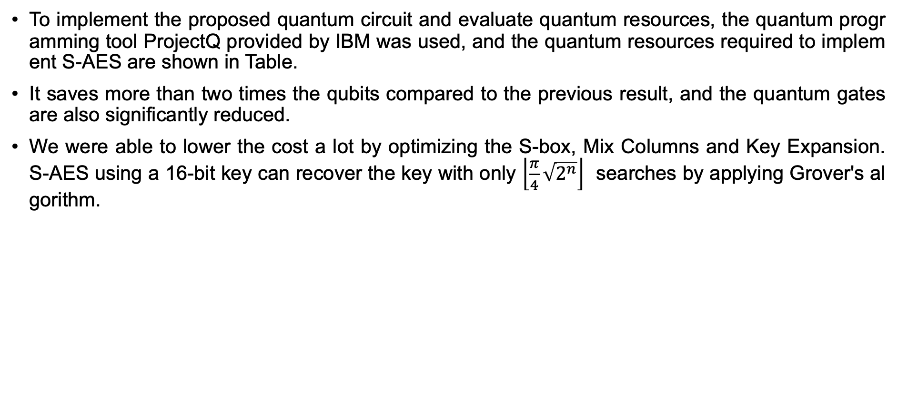
Evaluation
To implement the proposed quantum circuit and evaluate quantum resources, the quantum programming tool ProjectQ provided by IBM was used, and the quantum resources required to implement S-AES are shown in Table.
It saves more than two times the qubits compared to the previous result, and the quantum gates are also significantly reduced.
We were able to lower the cost a lot by optimizing the S-box, Mix Columns and Key Expansion. S-AES using a 16-bit key can recover the key with only $\left\lfloor \frac{π}{4}\sqrt{2^{n}}\right\rfloor$ searches by applying Grover's algorithm.

Slide 15
Conclusion
NIST estimates the Grover key search cost for symmetric key cryptography as the post-quantum security strength.
In the Grover key search, the attack cost is determined by how efficiently the target encryption process is implemented.
In this paper, Simplified AES is efficiently implemented as a quantum circuit, and the Grover key search cost is estimated based on this.
As a result, the attack cost was significantly reduced compared to the previous result.

